Slide 1

Context Free Grammar
---Sakshi Surve

Slide 2
Grammar :
Grammar is finite set of formal rules for generating syntactically correct sentences.
Any language requires Grammar , which defines correct statement formats or constructs allowed for that language
Hence, grammar is called as Syntactic Definition of the language
Here, we are to discuss grammar for formal languages , CFG (Context Free Grammar)

Slide 3
Constitutes of Grammar :
Grammar consists of two types of symbols :
Terminals
Non Terminals
Terminals are part of Generated Sentence
Non Terminals are NOT part of Sentence, but, of generation of Sentence

Slide 4
Non Terminals are essential for declaring the rules
These rules are called Production Rules
A grammar that is based on the Constituent structure is called “Constituent Structure Grammar” or “Phase Structure Grammar”

Slide 5
Context Free Grammar :
A Phase Structure Grammar is defined by a quardruple
G = { V, T, P, S }
Where,
V : Finite set of Non Terminals
T : Finite set of Terminals
S : Start Symbol ( S is a Non Terminal)
P : Finite set of Productions

Slide 6
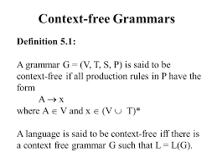
Definition :

Slide 7
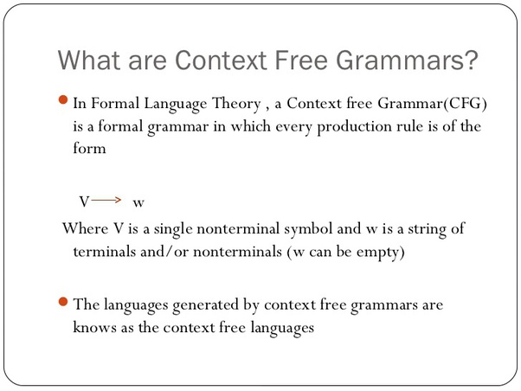

Slide 8
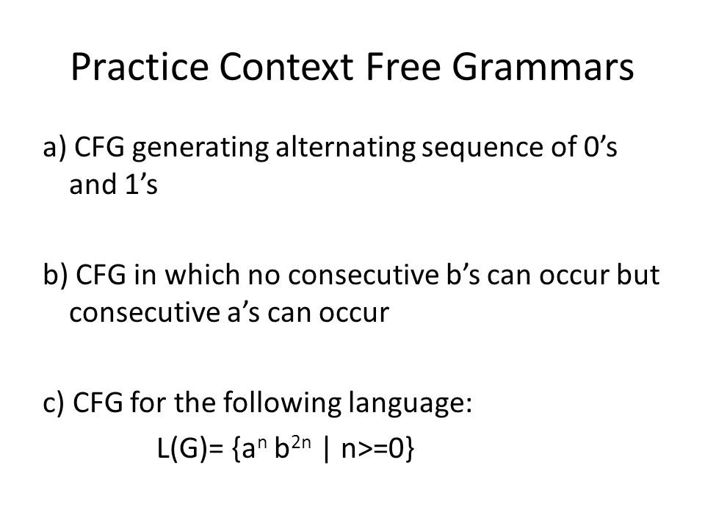

Slide 9
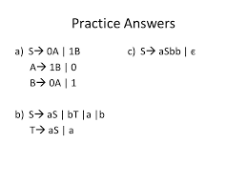

Slide 10
Example
V = {q, f,}
Σ = {0, 1}
R = {q → 11q, q → 00f,
f → 11f, f → ε }
S = q
(R= {q → 11q | 00f, f → 11f | ε })

Slide 11
Example
G = ({S}, {0,1}. {S → 0S1 | ε }, S)
ε in L(G) because S ε .
01 in L(G) because S 0S1 01.
0011 in L(G) because
S 0S1 00S11 0011.
0 1 in L(G) because S * 0 1 .
L(G) = {0 1 | n > 0}
n
n
n
n
n
n

Slide 12
How do we use rules?
If A → B, then xAy xBy and we say that
xAy derivates xBy.
If s ··· t, then we write s * t.
A string x in Σ* is generated by G=(V,Σ,R,S)
if S * x.
L(G) = { x in Σ* | S * x}.

Slide 13
Example
G = ({S}, {0,1}. {S → 0S1 | ε }, S)
ε in L(G) because S ε .
01 in L(G) because S 0S1 01.
0011 in L(G) because
S 0S1 00S11 0011.
0 1 in L(G) because S * 0 1 .
L(G) = {0 1 | n > 0}
n
n
n
n
n
n

